Slide 1
MULTI-GAME SYSTEM (C++)
Submitted in the partial fulfillment for the award of the degree of
BACHELOR OF ENGINEERING
IN
AIML
Submitted by:
Name: Akshay Kumar Kushwaha 20BCS6815
Shubham Singh 20BCS6816
Under the Supervision of:
SUPERVISORS NAME : Digvijay Puri Sir
Department of AIT-CSE
DISCOVER . LEARN . EMPOWER

Slide 2
OUTLINE
Introduction to Project
Problem Formulation
Objectives of the work
Methodology used
Results and Outputs
Conclusion
Future Scope
References

Slide 3
INTRODUCTION TO PROJECT
Name of our project is multi-game system as its name suggest it have multiple game and allow user(player) to choose any game from given games list and play it.
In beginning user(player) will be given some options.
Options as follows :-
Gaming Hub
Available games Played History
This project is made with the help of object oriented programming
Car game
Tic Tac Toe
Casino game
Word Guessing
Hangman
Instruction
Quit
Car game :51
Tic Tac Toe :21
Casino game :37
Word Guess :25
Hangman: 36

Slide 4
From given option as shown in interface user(player) can choose any option.
At the end of each game user(player) will be show time duration for which user(player) had played the game
It will also show the current date and time along with the time duration for which user(player) has played the whole game(time spend of multi-game system).
It also produces the beep sound in games like word guessing. To raise up the playing experience.
At the start of each game loading will be displayed to tell player to be ready.
The highest score updation, player name, word for word guessing and played history is updated through files with help of files handling so it is mandatory to have those files in system .
If the user(player) choose Car game. the gaming interface of Car game will open.
Detail About Car game:-
If the user(player) opted to play car game. user(player) will be showed loading screen and the game will be started
user(player) have to move car to left or Right to avoid car crashes with other
cars coming from the opposite side.
The Score of user(player) will be calculated on right side depending upon the
distance user have covered.
It will also calculated Highest score, to give a target to user(player) to break record of
highest score.

Slide 5
If the user(player) choose Tic Tac Toe. the gaming interface of Tic Tac Toe will open.
Detail About Tic Tac Toe:-
If the user(player) opted to play Tic Tac Toe game. user(player) will be first asked to
Choose option from given option of :- 1 for Single player(Human vs Computer), 2 for
double player(two humans), 3 for quit.
After selecting one option user(player) will be asked to Enter His/hers name.
As the Tic Tac Toe game have nine blocks , Each blocks will be given numbers from 1 – 9
by pressing the number user(player) can mark cross in the block.
If the user(player) chooses used block, a notification will be shown as : The “X” is invalid.
“X” is block number pressed by user(player).
If the user(player) choose Casino game the gaming interface of Casino game will open.
Detail About Casino game:-
If the user(player) opted to play car game. user(player) will be first asked to Enter His/hers name.

Slide 6
Then user(player) will be asked the amount he wants to deposit.
Then user(player) will be asked to enter amount for first round.
Then user(player) will be asked to guess a number between 1-9, if the number guessed will be same as the number generated by system user will won the 8 time the money had bet. After loosing 4 times in row user(player) will also get special offer of lucky draw. Which gives only two numbers for guessing to increase the winning probability of the user(player).
If the user(player) choose Car game. the gaming interface of Car game will open.
Detail About Word guessing :-
After starting the word guessing game user(player) gets a quick instruction of the game.
Then user is shown the word with missing alphabet, from which user have to guess the word and type the word including with the alphabet those are missing.
If the user(player) enters wrong answer -2 of the score will be deducted.
If the user(player) enters correct answer user(player) will +points and a beep sound along with green screen to show a positive sign.

Slide 7
Detail About Hangman game :-
In this game user(player) will be given blanks according to the number of letters present in the word
User(player) will be given hint below , regarding the word.
If the user(player) Enters wrong alphabet a structure of hanging man will start creating with each incorrect letter.
And if the user(player) successfully enters all the letter before the structure is created fully.
User(player will win the game.
With each incorrect word score will be deducted and with each correct alphabet score will be added.

Slide 8
At the end of the every game user(player) will be showed elapsed time of each game.
At the end of game user(player) will be showed current day , date and time as well as time duration for which user(player) has played the whole game(sum of all elapsed time).
At the end of each user(player) will be asked for a rematch. If user(player) chooses Y(yes), user(player) can continue to play. And N(No) for exiting.
If the user(player) choose Instruction the interface with some instruction which will help user(player) to understand multi-game system.
If the user(player) choose Quit the multi-game system will be closed.
Now use of Played history function as shown in interface.
It will Count the number of times user(player) has played each games. or we can say how many times user(player) has visited options under Available games except quit.

Slide 9
PROBLEM FORMULATION
The need of this projects named as Multi –game system are as follows:
To improve the concept of different header files.
To learn in deep concepts of object oriented programming language.
This game allows user(player) to choose games as it have the list of the games and we can add more games in the list in future.
For relieving stress
As we all are aware that everyone is dealing with a stressful life now-a-days and looking an easiest way to cope with it. And for this problem this multigame system will help user to use their spare time to get relaxed.
Less Requirements
As we know other games requirements are too high and complex and it is difficult for everyone to manage those requirements as a help and to solution to this problem this multi-game system requires very less requirements and everyone can enjoy it.

Slide 10
OBJECTIVES
The need of this projects named as Multi –game system are as follows:
To improve the concept of different header files.
To learn in deep concepts of object oriented programming language.
To implement all kind of concept of c ++.
By using c++ programming language we will come to know that how it is different from other object oriented programming language.
To keep track of played history automatically.
To keep track on time duration for which game has been played automatically.
To keep track on current date, day, and time.
To keep track of name and highest score which player has achieved .
To display hunters (Ace players) highest score. To motivate new player to break their record and create anew one.

Slide 11
Methodology used
Front view
Multi Game
system
Player view
Car Game
Save Car
Tic Tac Toe
Challenge to win
Casino
Guess and win
Word Guess
Brilliant mind
Hangman
Save yourself
Run and Save
Attacking enemy
Play with Computer
Engineering
Director
Try your luck
Use random algo
Guess most common words
A small imagination
Guess using spaces
Given hint
Beat Highest score
Be a legend
Play with identity
Make a perfect move
See extra lucky offers
Extra pack read side message
Score and don’t loose
Best suitable word
Score multi mythology
Extra pack read instruction
Beat and Score
Win to create score
Use worst case
1 offer to win M
Save to be hanged
Try and hit multi case
Save to be hanged
Try and hit multi case
Play with another
Real person
Play and follow Rule
Make a perfect move
Beat your Enemy
Win to create score

Slide 12
Middle View
Score by hunt words
Beat high score
Luck and guess single number
Guess
Star printed
Use word limit
Extra Pack
Worst case pack available
Word Hunt
Hunt to score
Casino
Be a Milliner
Computer vs player
Use mind not random comp. method
Car Game
Save Car
Gaming Hub
Main
Tic Tac Toe
Be ligand
Make Score
Find path to be safe
Player 1 vs player 2
It’s on players
Scores
Manage same time winner
Hangman
Hang own
instructions
All game rule book
Hint use and Hunt
Words according to hint
Score for batter play
High score

Slide 13
Mirjam Nilsson
President
Backend view
Saved data
History of Game
Hangman
Hunt words
Word Guess
Mind refresher
Car Game
Running values and show cases
Casino
Bet and Win
Instruction
Rules for each sections
Tic Tac Toe
Legend Play
Mind relax
Space to write
Direct input system
Star printed word
use manual and player choice to know
View model
Continuous user view
Lucky Number
User to choose there
Rules
Using every section function
Computer
Using random guess to play
Hints
Using word dictionary and rules
Kalle Persson
Product Manager
Winning number and extra pack generation
Random generation
User to View
Wait key and option to stop and read
2 players
Free choice strict rules
Lines of input
According to word length
Update data
History of Game
Scores
Calculate while playing

Slide 14
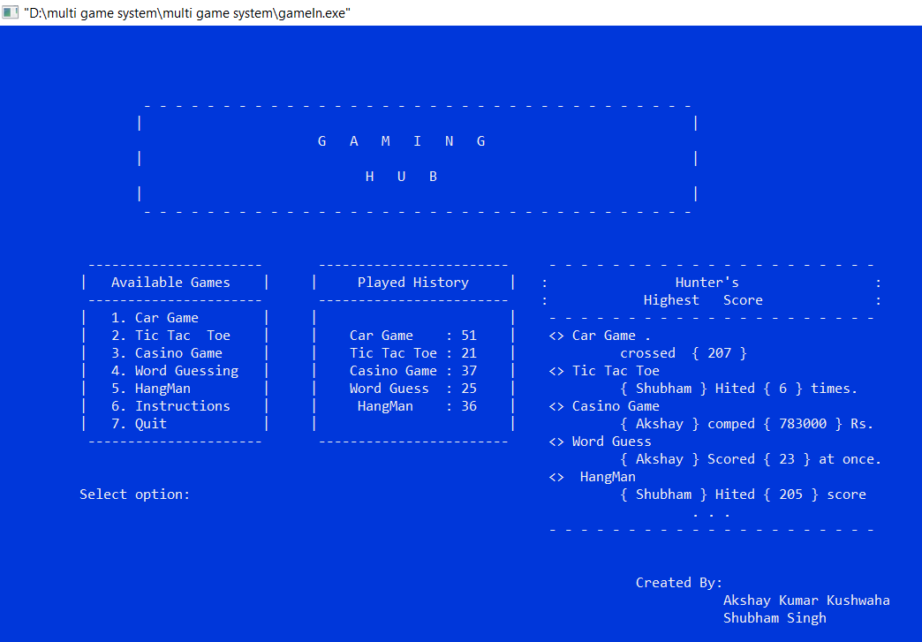
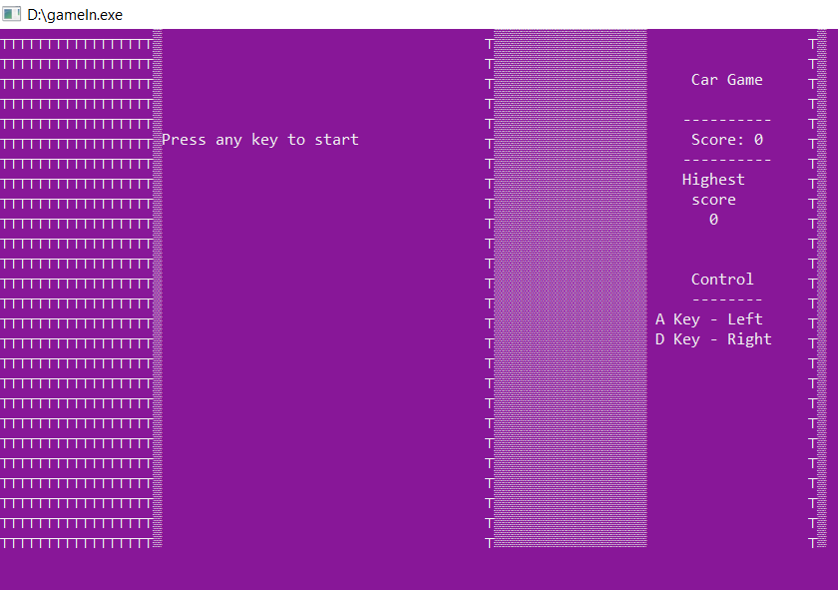
RESULTS AND OUTPUTS
Main Interface
After selecting option 1

Slide 15
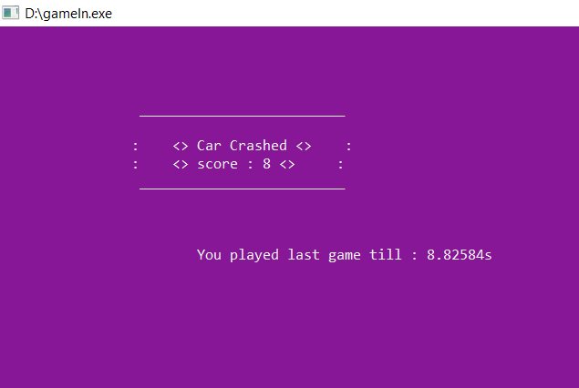
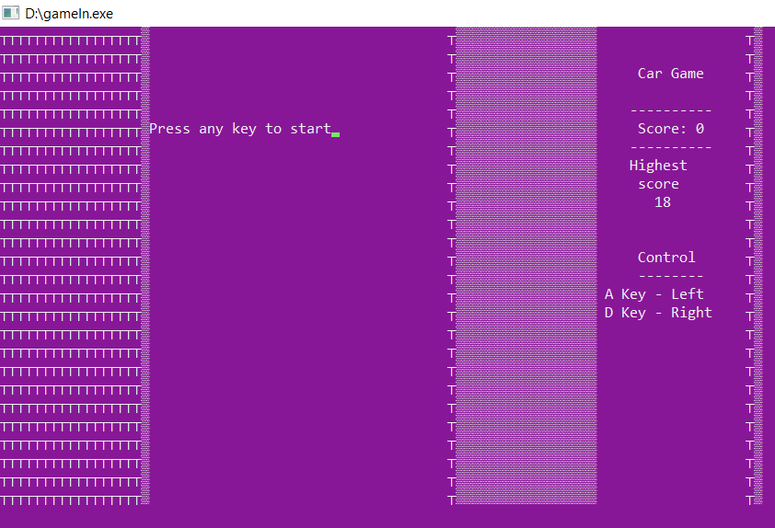
After car Crashes
elapsed time is shown after every game as mentioned in introduction.
After Again selecting Option 1
After selecting car game again previous highest score is shown as Mentioned in the introduction

Slide 16
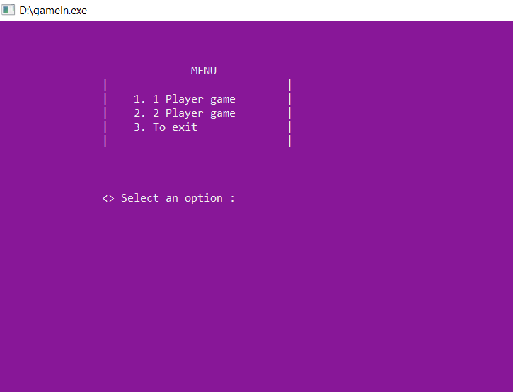
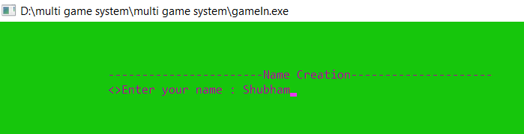
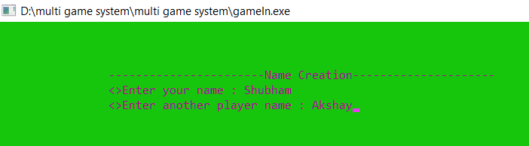
After Selecting option 2(Tic Tac Toe)
User asked to selected playing mode option
After Selecting 1 player
Player Asked to Enter His/Hers name
After Selecting 2 player
Players Asked to Enter their names

Slide 17
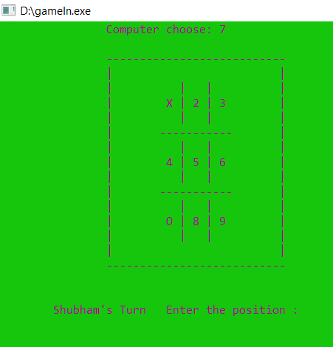
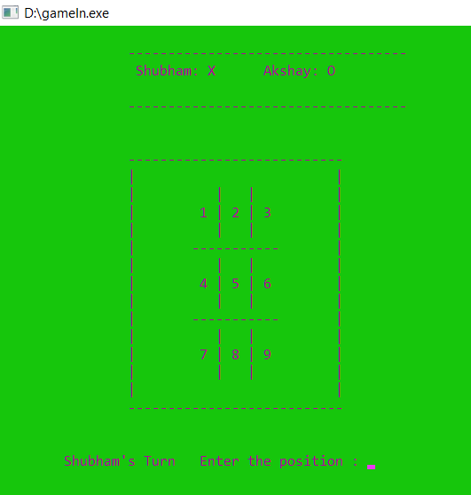
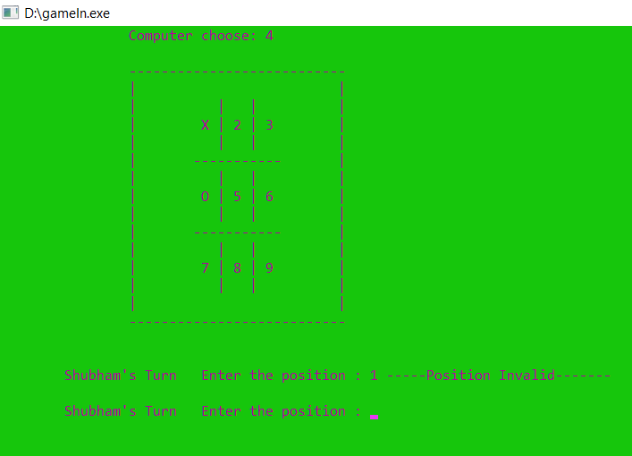
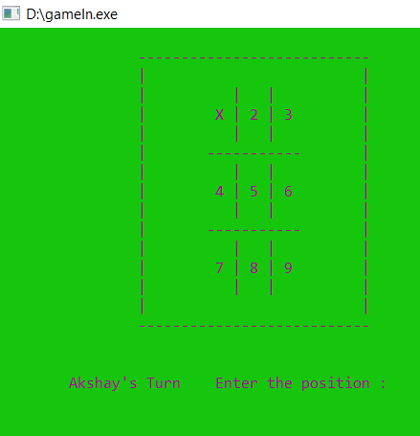
Single Player
Double Player
Player 1 asked to enter position
Player asked to enter position
Player asked to enter 2nd position and After entering same position again player get error
Player 2 asked to enter position

Slide 18
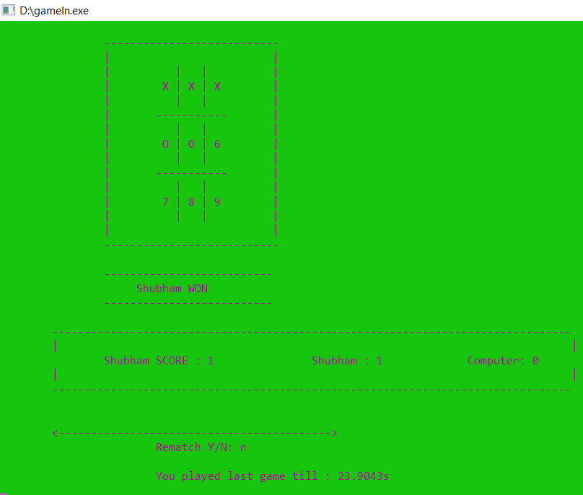
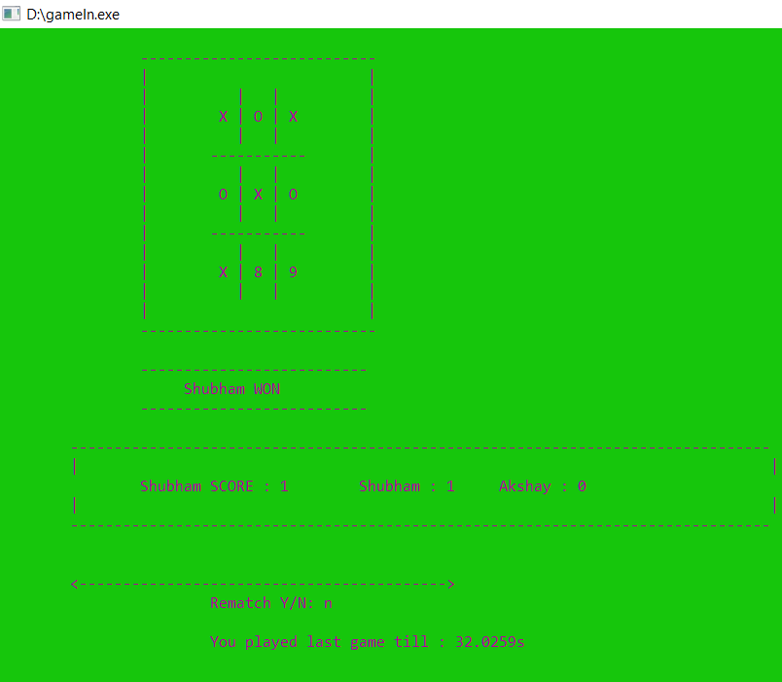
Single Player
After End of Game
Score is shown.
Double Player
After End of Game
Score is shown.
Rematch option and duration time for which game has been played showing as Mentioned in the introduction

Slide 19
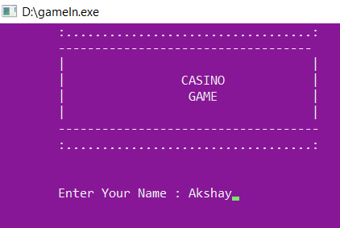
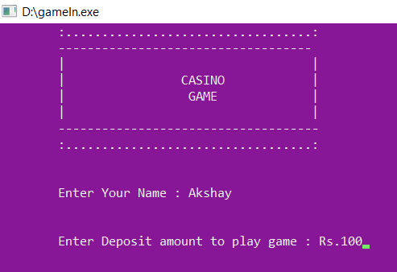
User Asked to Enter his/hers name
User Asked to deposit amount to play

Slide 20
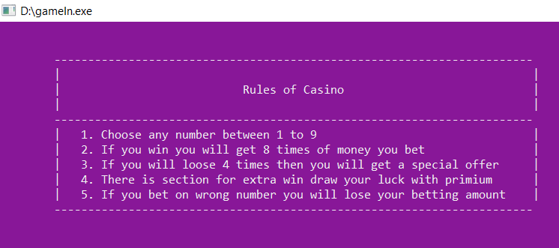
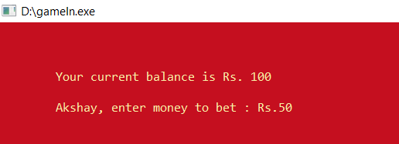
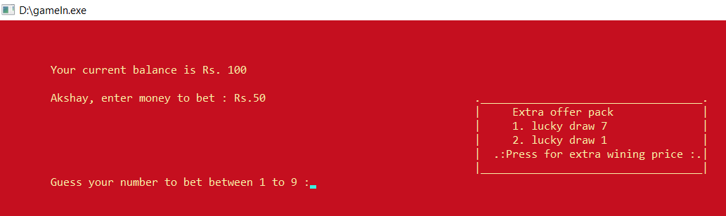
A Quick Rule book
User Asked to Enter betting money from deposited Amount
User asked to guess number

Slide 21
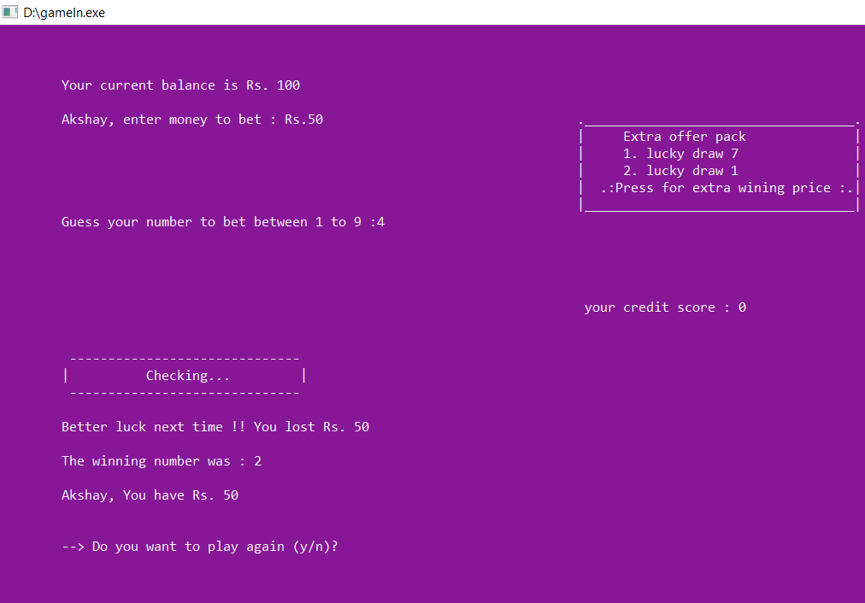
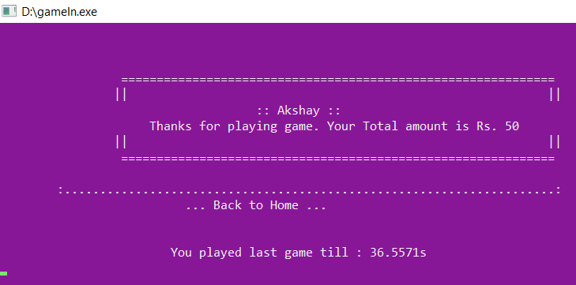
Results of betting
Thanking and displaying remaining Amount
Taking back to home(as user entered “NO” for rematch)
Duration time for which game has been played showing as Mentioned in the introduction

Slide 22
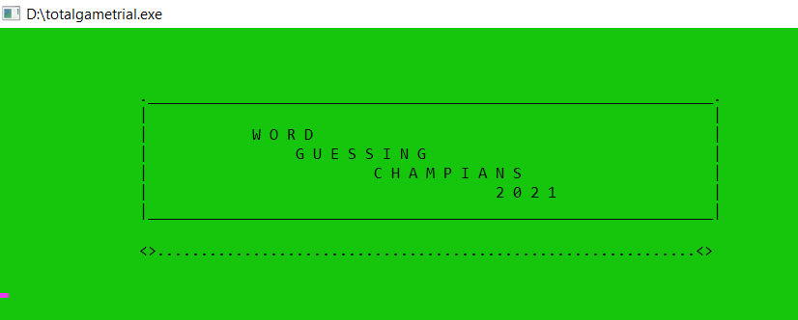
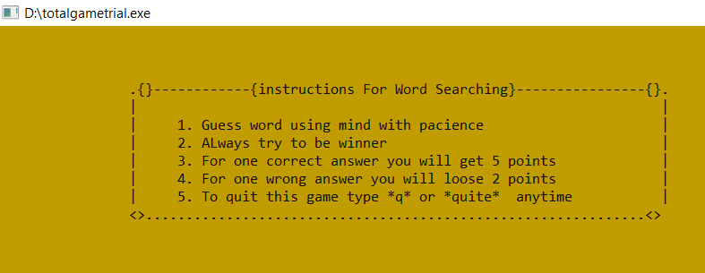
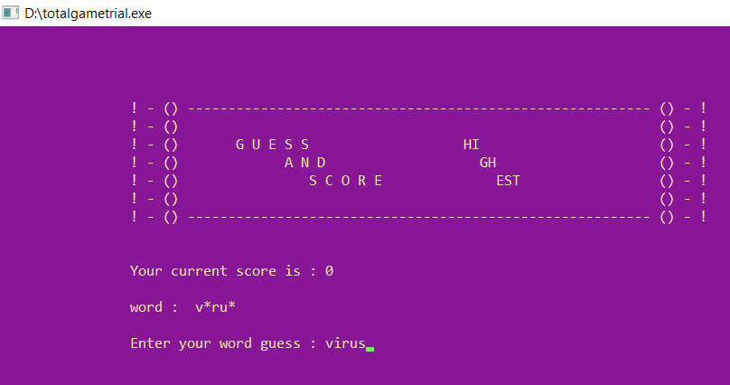
After inputting 4
A quick rule book
Word with missing letter and
Answer given by player.

Slide 23
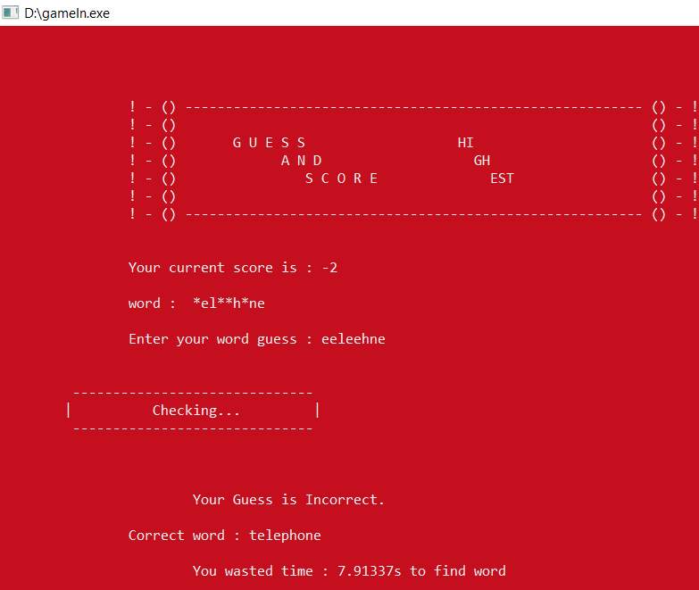
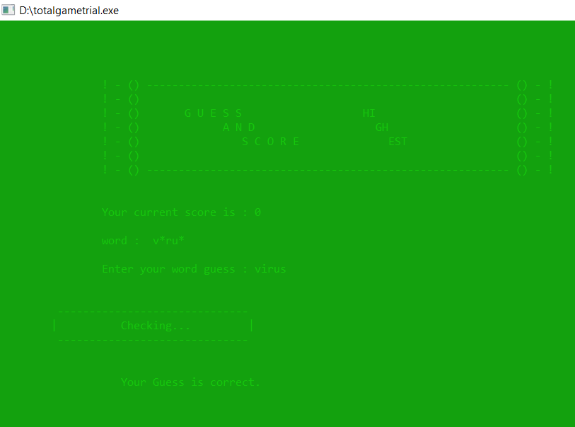
After entering the answer the wrong answer red screen
Red screen and different beep sound for incorrect as mentioned in introduction
After correct answer.
Green screen and beep sound for correct as mentioned in introduction

Slide 24
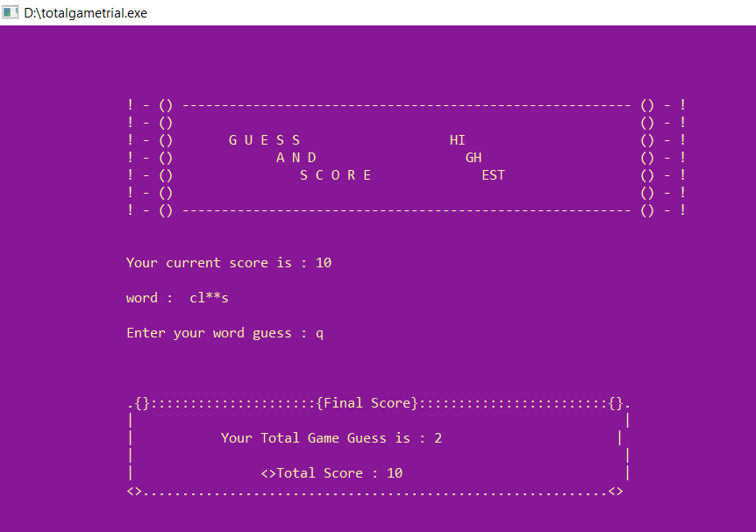
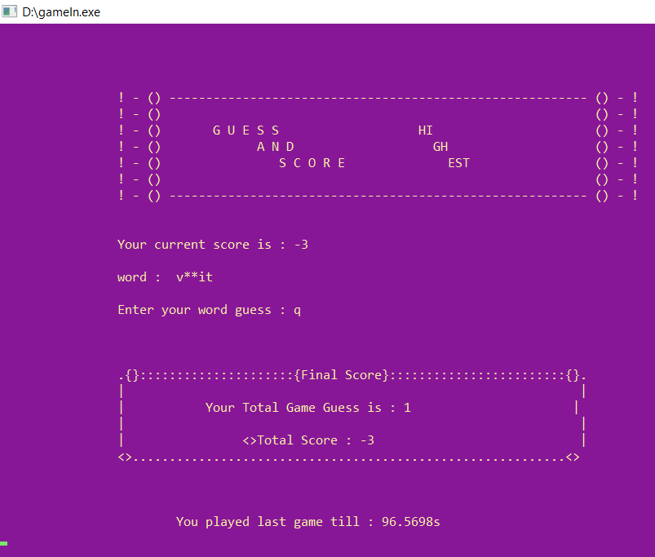
After Entering q/quite for exiting the game.
Final score with total number of guesses
quit or q for quitting the game Mentioned in the introduction
Duration time for which game has been played showing as Mentioned in the introduction

Slide 25
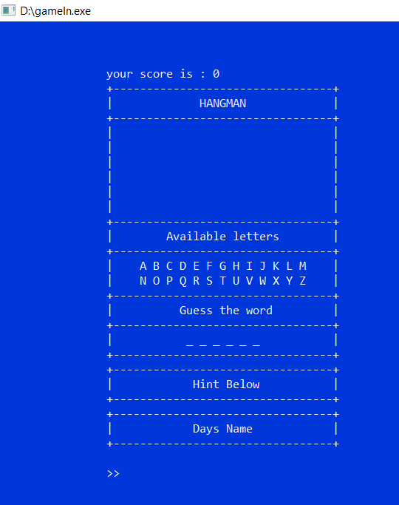
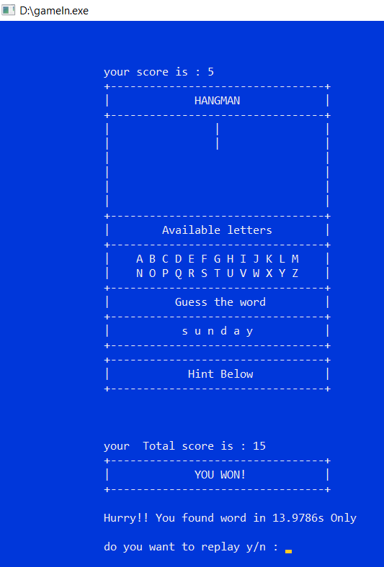
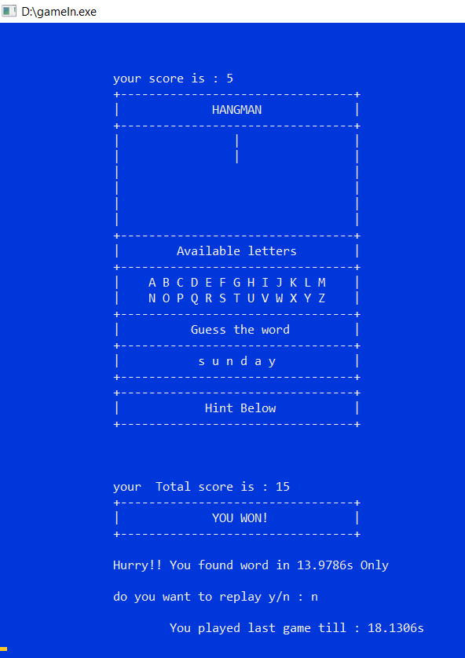
For entering the answer hint is given below
After entering the answer score and time taken to write the enter word
At the end asked for rematch, after entering no for rematch total time taken from starting to end displayed

Slide 26
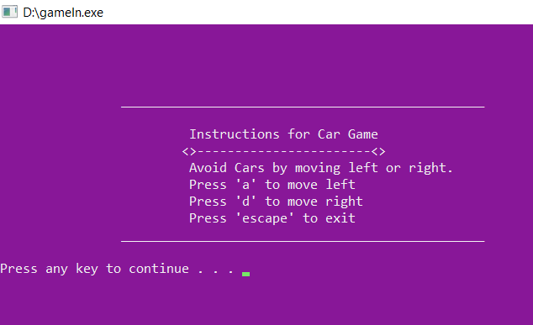
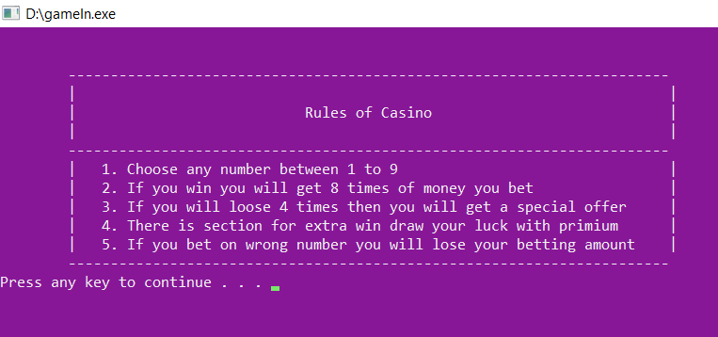
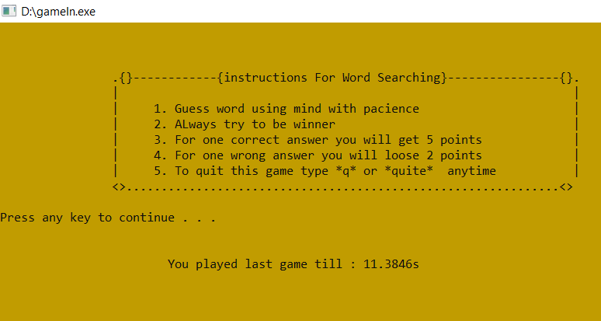
A Instruction for car game after selecting option number 6.
And after pressing any key.
Instruction for other game which is casino game
And after pressing any key.
Instruction for other game which is word searching game
Time taken to read all instruction asMentioned in the introduction

Slide 27
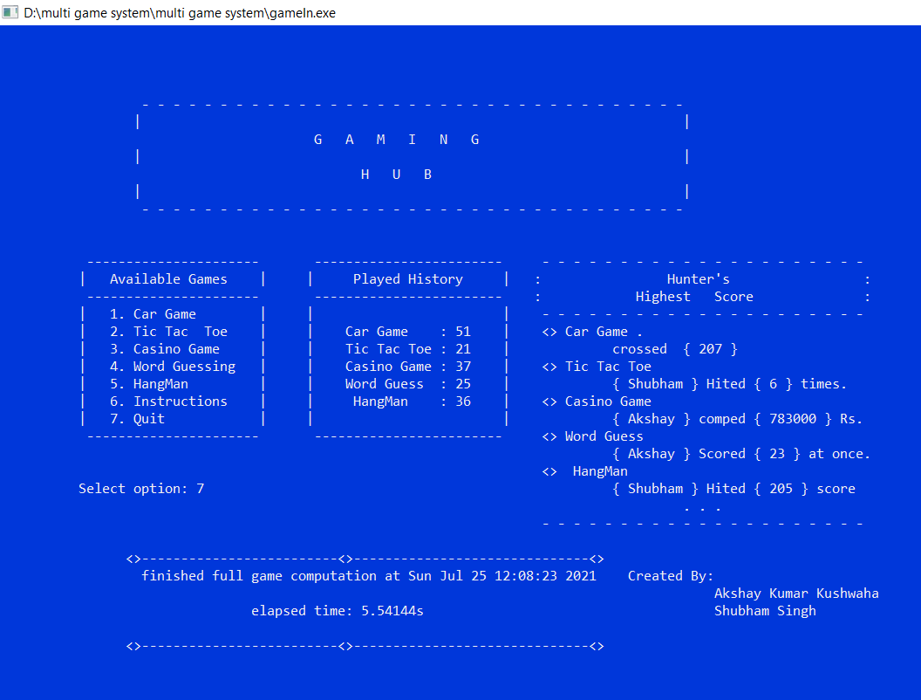
After selecting option number 7.
Current day, date ,time along with total time spend on multigame system.(sum of time spend on every game is reflected at the very end)
As mentioned in introduction.

Slide 28
CONCLUSION
Name of our project was : Multi Game System.
It consists of some different types of Games.
It allows user(player) to Select any game from given games list, and to play it.
It also consist of option named played history , which counts and display number of time a particular game is played or visited.
It also contain an option for instruction which gives some quick instruction to the player for ease of playing and better understanding.
It produces a beep sound for user(player) for better experience.
It stores the score by help and use of file handling.
It update name and new highest score accordingly automatically.

Slide 29
Future scope for the project named Multi game system is as follows:
We have left many option left for the updation of the project.
As we know now-a-days player are versatile so we can many new games in future.
We can give more advance software for multi game system including more facilities.
We can host the platform on online servers to make it accessible worldwide.
We can add more games in list of available games list.
The beep sound is already included in game, for further more improvement we can add theme song in particular game for better experience and fun.
FUTURE SCOPE

Slide 30
REFERENCES
[1] Timer: https://stackoverflow.com/a/27856440
[2] Hangman: https://www.youtube.com/watch?v=dnZfFKh-Nz8&t=1s
[3] Word guessing:
https://www.google.com/search?q=word+guessing+game+c%2B%2B&oq=word+guessing+&aqs=chrome.1.69i57j69i59l2j69i60.8662j0j4&sourceid=chrome&ie=UTF-8
https://github.com/jayprakashkumar1/word-guessing-game
[4] Casino game:
http://www.cppforschool.com/project/casino-game-project.html
[5] Car game:
https://www.google.com/search?q=car+game+in+c%2B%2B+without+graphics&oq=car+ga&aqs=chrome.0.69i59l2j69i57j69i60l3.18871j0j1&sourceid=chrome&ie=UTF-8
https://www.youtube.com/watch?v=X4LyyvGLABg
[6] Tic Tac toe:
https://www.google.com/search?q=tic+tac+toe+game+in+c%2B%2B&oq=tic+tac+toe+game+in+c%2B%2B&aqs=chrome..69i57.12890j0j1&sourceid=chrome&ie=UTF-8
https://www.geeksforgeeks.org/implementation-of-tic-tac-toe-game/

